Slide 1
Credit Score
CS539
Axel Luca, Preet Patel, Xiaojun Liu

Slide 2
Problem Motivation and Description
Credit scoring is a critical process in the financial industry, determining the creditworthiness of individuals applying for loans, credit cards, and other financial products. Accurate credit scoring models help financial institutions minimize risk, make informed lending decisions, and offer appropriate credit limits. By ensuring that credit decisions are based on reliable and comprehensive assessments, financial institutions can extend credit to deserving individuals and businesses who might otherwise be overlooked if the process was done by someone manually. However, building robust and accurate credit scoring models is challenging due to several factors: imbalanced data, complexity of features, and need for adaptability over time. We try and combat these factors with our model.

Slide 3
Dataset

Slide 4
Dataset
The Credit Score Classification dataset, available on Kaggle, contains information necessary to build and evaluate models for predicting credit scores.
Payment_of_Min_Amount: Minimum amount paid indicator.
Delay_from_due_date: Average number of days delayed in payment.
Credit_Mix: Credit mix indicator.
Outstanding_Debt: Total outstanding debt.
Changed_Credit_Limit: Credit limit change indicator.
Credit_History_Age: Age of credit history.
Payment_of_Min_Amount: Minimum amount paid indicator.
…
Dataset link: https://www.kaggle.com/datasets/parisrohan/credit-score-classification/data

Slide 5
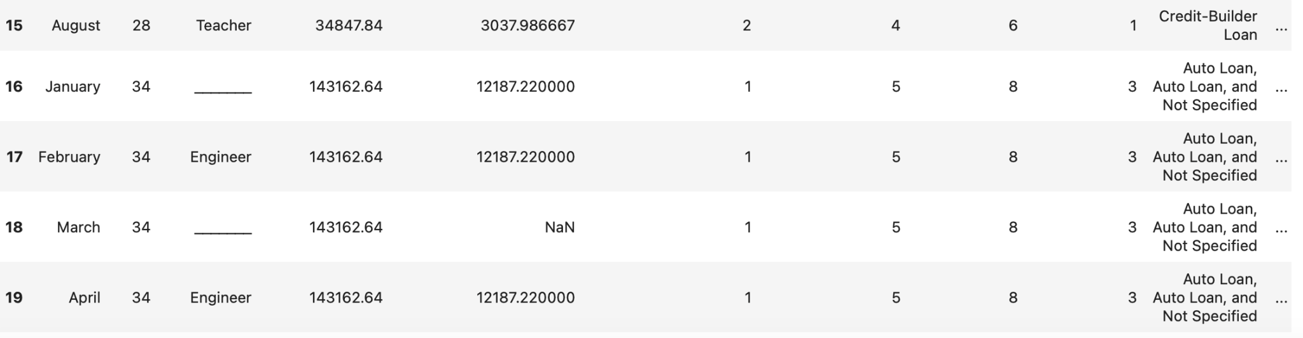
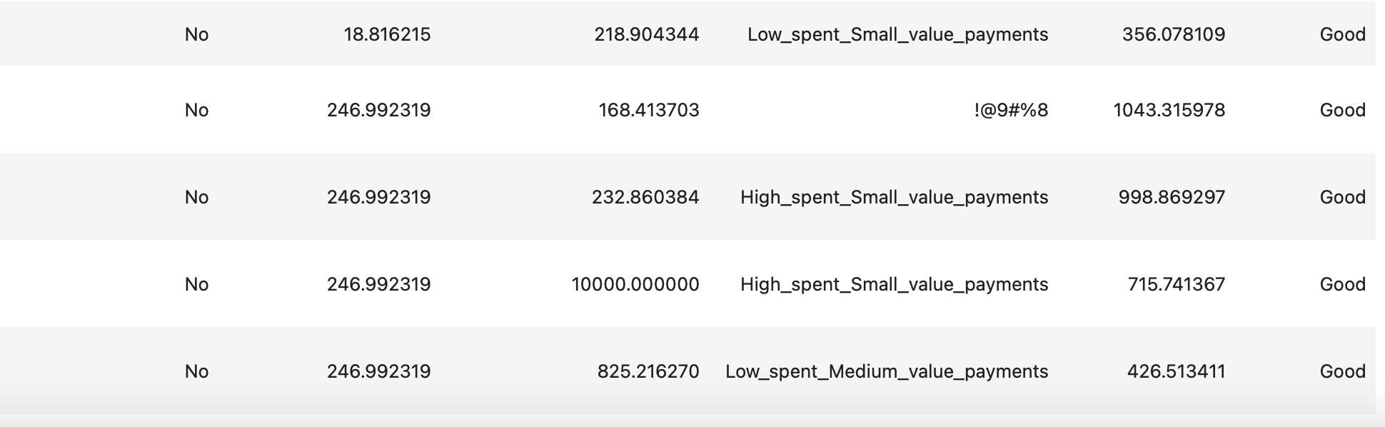
Data Cleaning
When we first obtained the dataset from Kaggle, the data had several issues such as some data instances having values that weren’t numbers, clear outliers in the data such as a negative age, and some data instances having strange symbols.

Slide 6
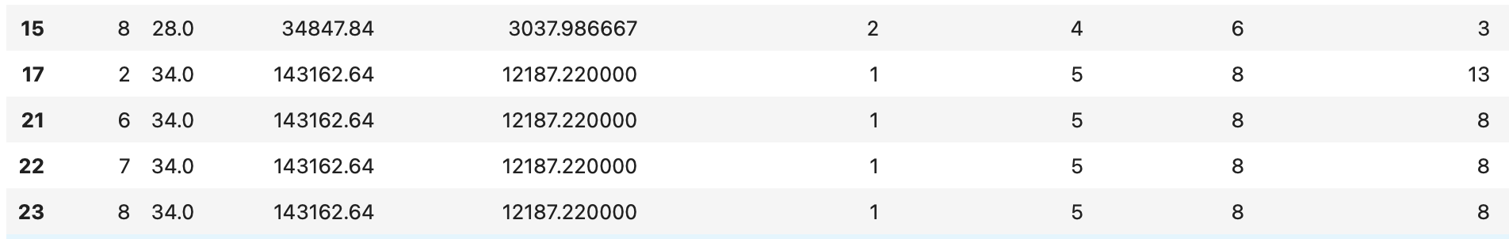
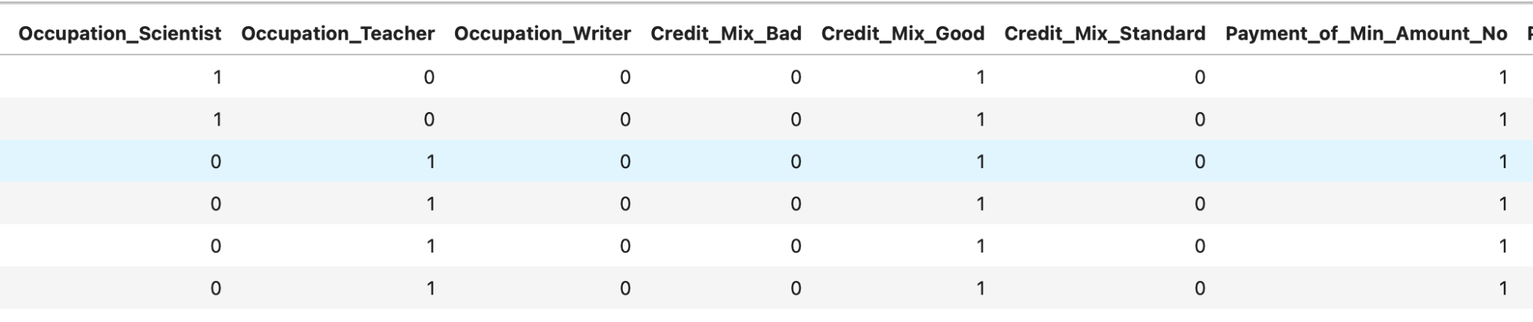
Data Cleaning
To address these issues, several techniques were applied such as dropping irrelevant features such as the "Name," "SSN," "ID," and "Customer_ID, creating our own functions in Python to deal with outliers, removing the data instances that had strange symbols, and converting categorical variables that did not have a specific ranking or ordering into one-hot encodings, and converting the ones that did to numbers based on their rank or slot in their corresponding sequence.

Slide 7
Synthetic Minority Over-Sampling Technique
(SMOTE)

Slide 8
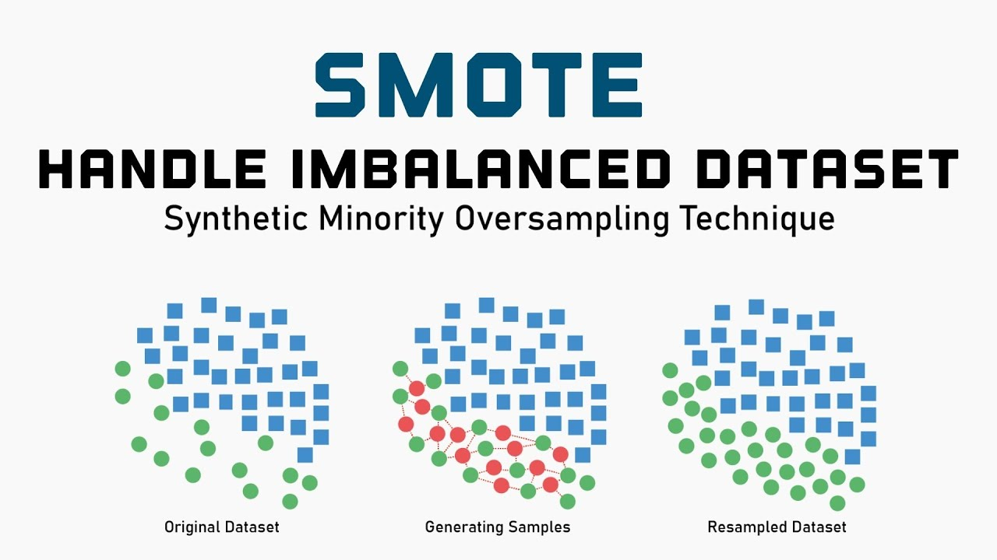
What is SMOTE?
Addresses class imbalance in datasets
Creates synthetic examples of the minority class
Advantages:
Improves model performance
Reduces overfitting
Widely Applicable

Slide 9
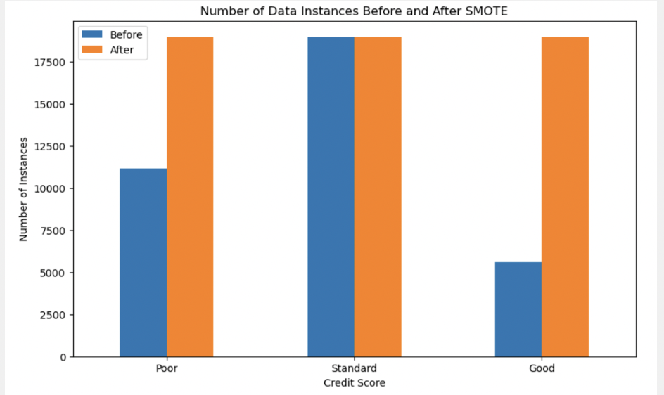
How it helped our project?
Our dataset was imbalanced in the Credit_Score target variable:
- Poor class: 11,139 instances
- Standard class: 18,959 instances
- Good class: 5,593 instances
Applied SMOTE to make sure the target variable was equally represented in the dataset in order to train a fair and effective model

Slide 10
Elastic-Net

Slide 11

What is Elastic Net?
A compromise between lasso and ridge, penalizing a mix of absolute and squared size
These ratio of these two penalty types(l1_ratio) and the regularization strength(alpha) should be tuned
Tuning of these hyperparameters depends on the dataset and problem

Slide 12
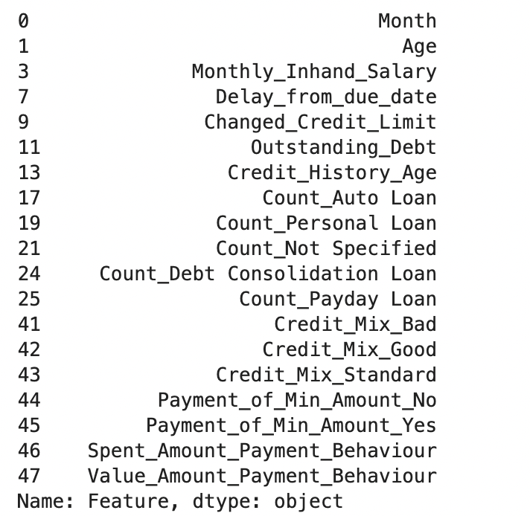

Fitting the Elastic Net Model
Alpha = 1, L1_ratio = 0.5
Alpha = 0.15, L1_ratio = 0.1

Slide 13
Stacking Classifier

Slide 14
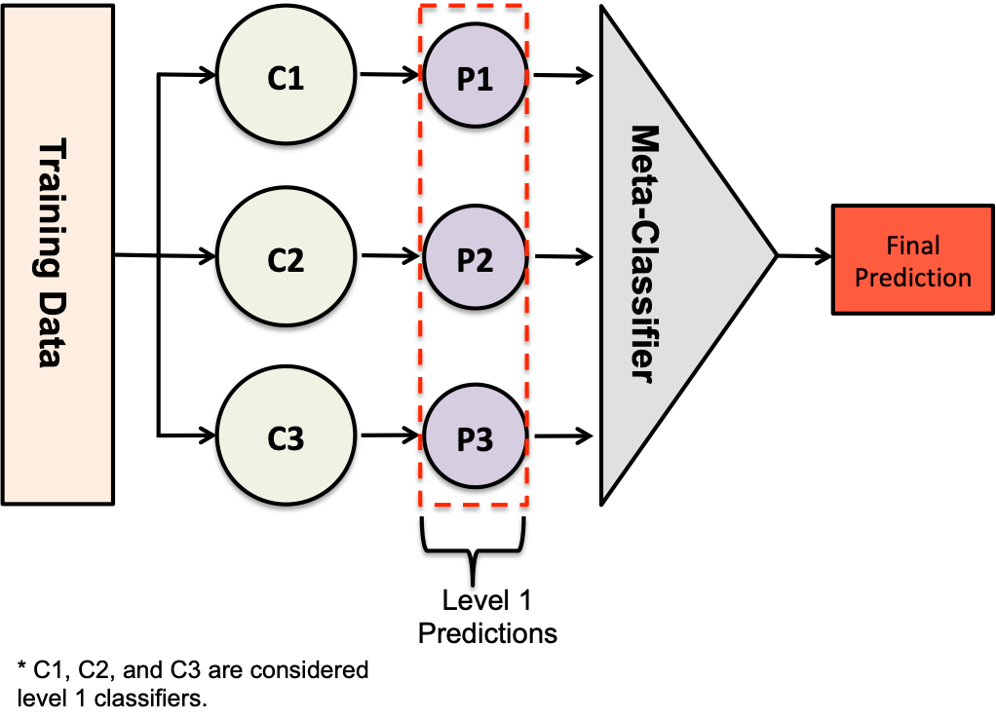
Stacking Classifier
As part of our project was to make a model that combines multiple machine learning classifiers to make predictions with the help of the classifiers’ strengths, we decided to use a Stacking Classifier to accomplish the task. Here is information regarding a stacking classifier’s typical components:
Base Classifiers: Several diverse base classifiers are trained on the same dataset. These can be different types of classifiers (e.g., decision trees, SVMs, neural networks) or the same type trained on different subsets of the data.
Meta-Classifier: A meta-classifier (or blender) is then trained on the predictions of the base classifiers. Instead of using the original features, the meta-classifier uses the outputs (predictions) of the base classifiers as its inputs. This meta-classifier then makes the final prediction.

Slide 15
K-Fold Cross-Validation

Slide 16
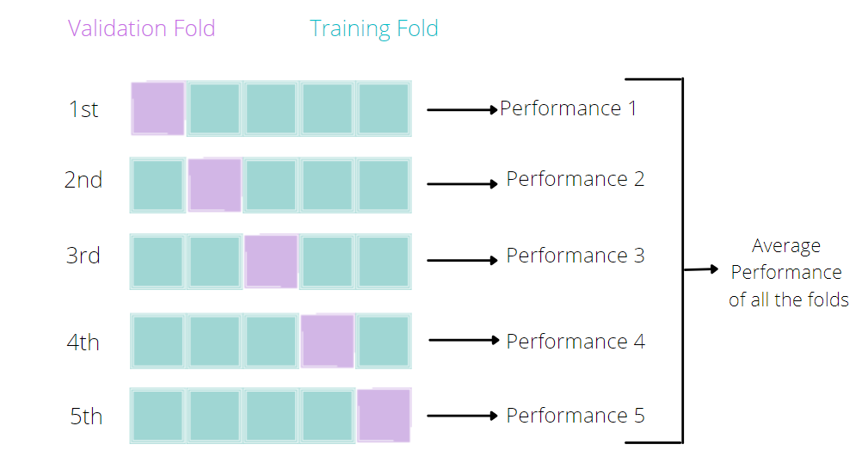
K-Fold Cross-Validation
Advantage:
Provides a more accurate estimate of model performance compared to a simple train-test split. Utilizes the entire dataset for training and validation, which is beneficial especially when the dataset size is limited.

Slide 17
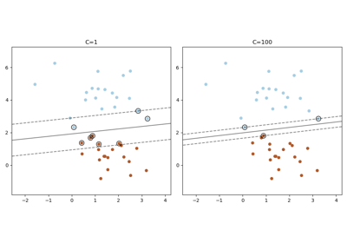
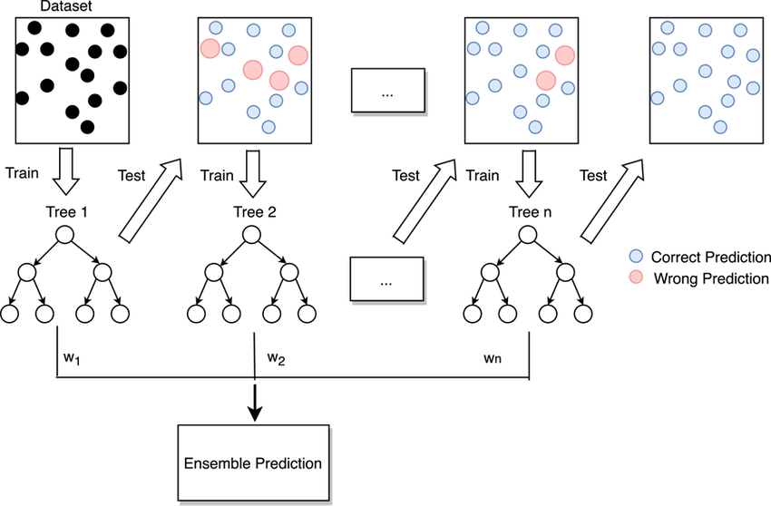
Building the Model
1）Defining Base Classifiers:
The base classifiers we selected were a linear SVM classifier as it is a good choice when dealing with datasets with a large amount of features and for modelling linear relationships between them. We then combined this classifier with an eXtreme Gradient Boosting Classifier, a powerful gradient boosting classifier used for large datasets and known for its performance and efficiency and its ability to model relationships between variables that are more complex than linear.

Slide 18
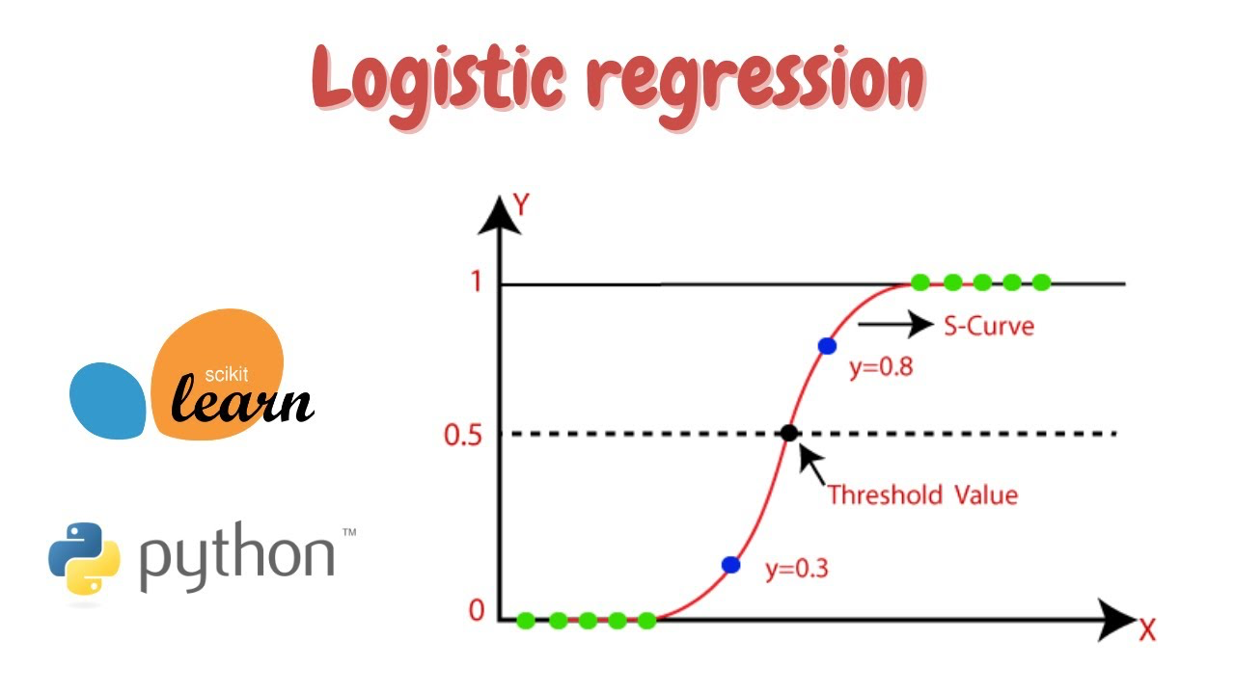
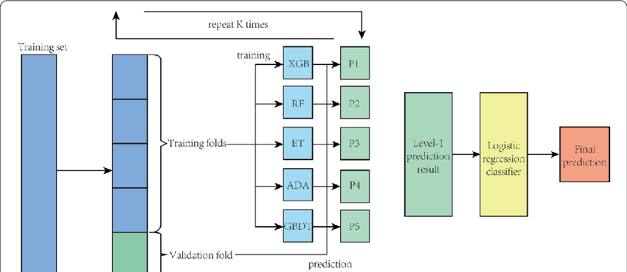
Building the Model
2) Defining the Final Classifier: As the final estimator to combine the predictions from the base classifiers described above, we thought that the logistic regression was a good choice for the final classifier due to its simplicity, interpretability, and its effectiveness in predicting discrete variable outcomes.
3) Building the Stacking Classifier: In our stacking classifier, cross-validation is used to split the our project dataset into multiple folds. For each fold, the models used as based estimators are trained the training portion of our dataset consisting of the remaining K-1 folds. Once that is done, the predictions of the base estimators on the current validation fold are used to train the stacking classifier's final estimator, which combines these predictions to improve the overall classification performance.

Slide 19
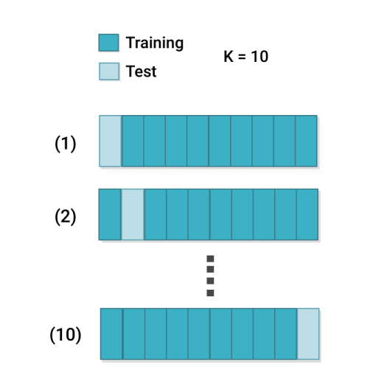
Training and Testing the Model
1）Setting Up 10-Fold Cross-Validation
In our project, we have set up K Fold cross-validation with 10 splits. For each fold, we had 90% of the data used for training the model and 10% of the data used for testing the model for both. In addition to this, shuffling was added to our model to ensure that each fold is representative of the entire dataset. Shuffling randomly distributes the data points, ensuring that each fold contains a diverse subset of the data.

Slide 20
Results

Slide 21
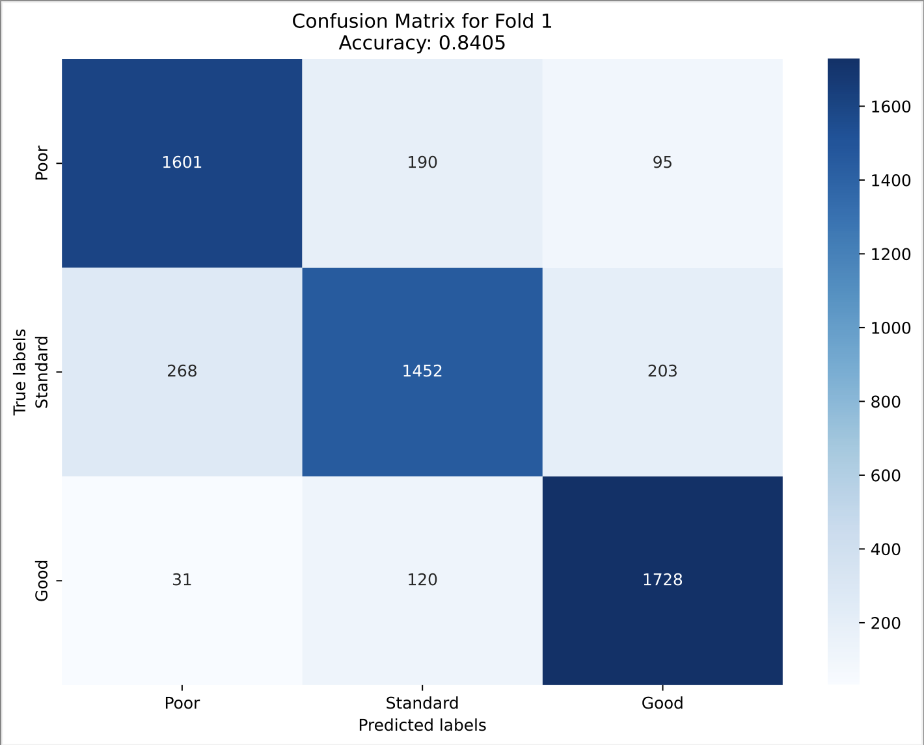



Results
As the main goal of our project is to produce a machine learning model that can classify credit scores as accurately as possible, we decided to use accuracy as the machine learning metric to evaluate our finalized model. Our finalized model performed relatively well with a median accuracy of approximately 84.07% and a mean accuracy of approximately 84.11%.

Slide 22
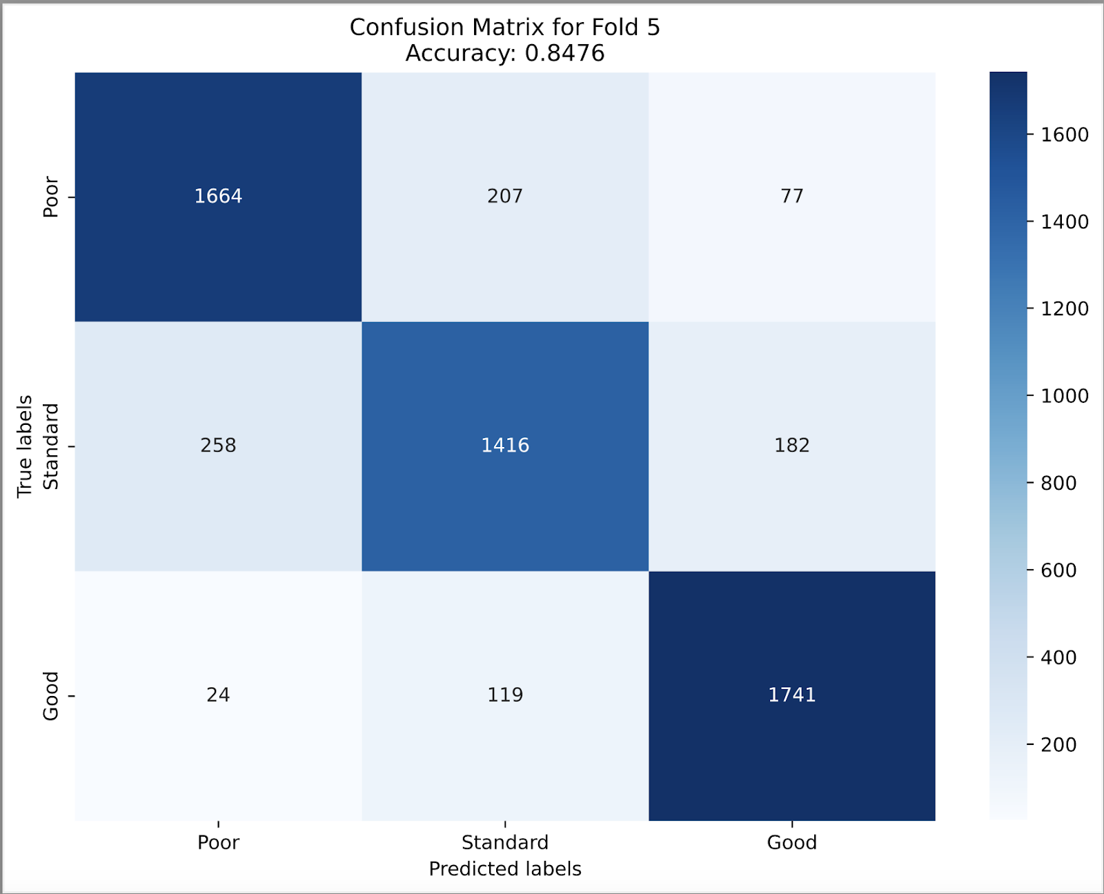


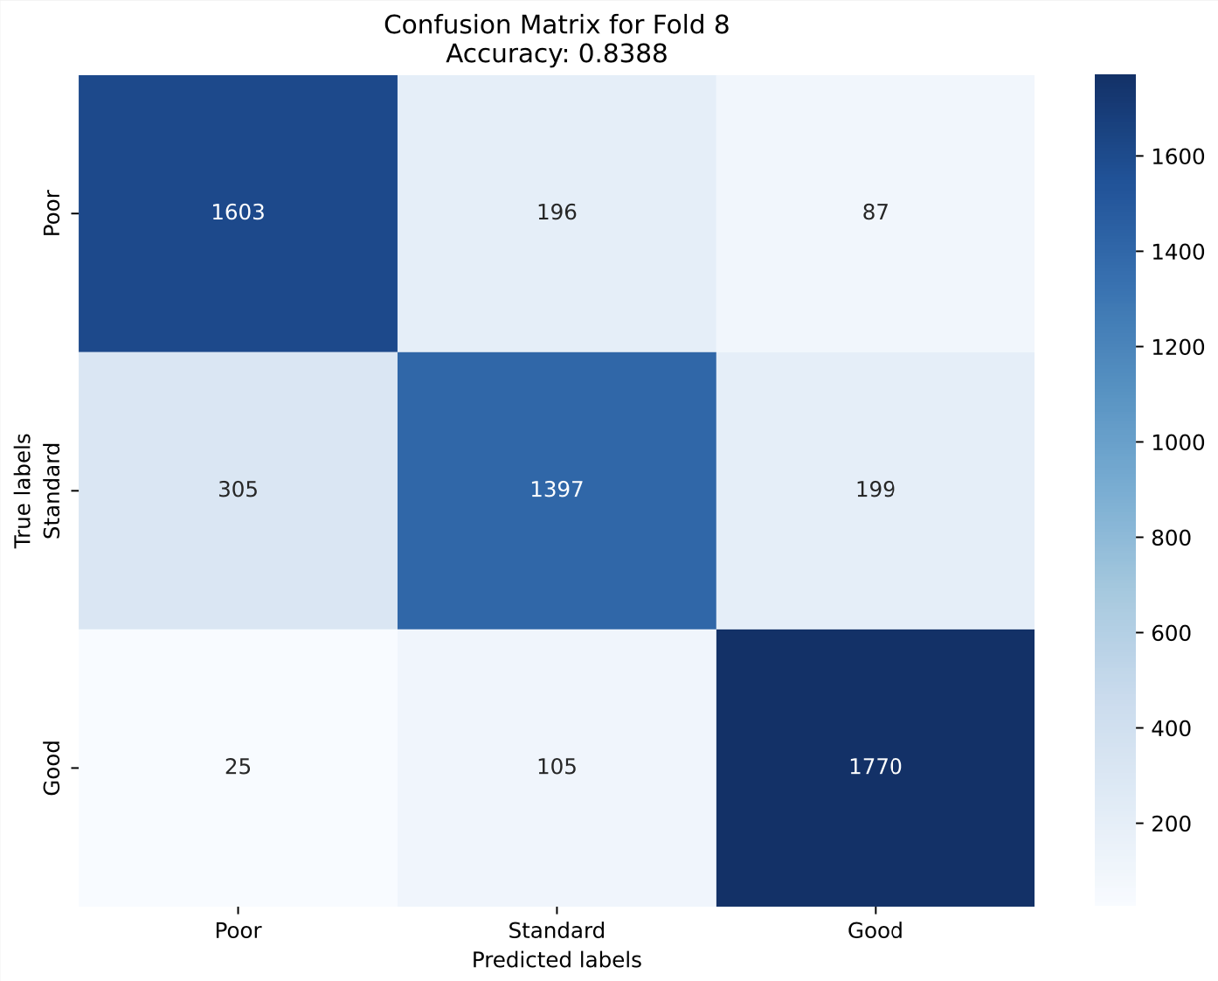
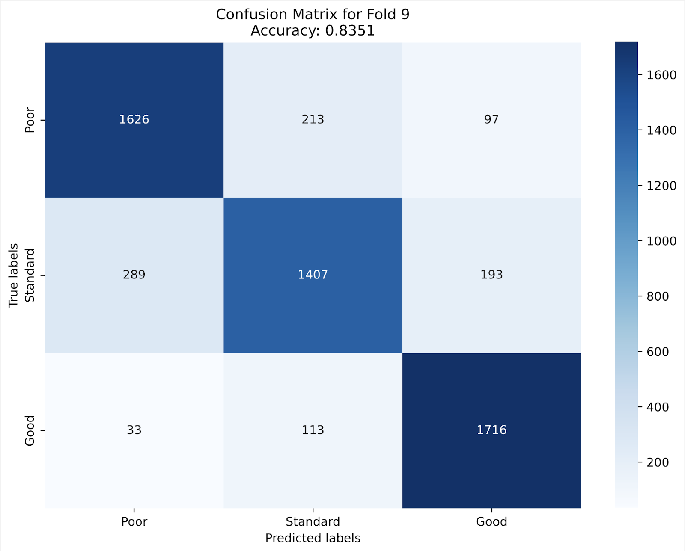

Results

Slide 23
Thank you!

Slide 24
Bibliography

Slide 25
Bibliography
Highradius. (n.d.). Credit scoring models: Types and examples. Highradius. Retrieved from https://www.highradius.com/resources/Blog/credit-scoring-models-types-and-examples/
Varga, G. (2023, July 11). Understanding credit scoring for fintechs. Oscilar. Retrieved from https://oscilar.com/blog/credit-scoring-guide
Fengff1292. (n.d.). Credict score prediction by NGBoost. Kaggle. Retrieved July 18, 2024, from https://www.kaggle.com/code/fengff1292/credict-score-prediction-by-ngboost
Satpathy, S. (2020). SMOTE for imbalanced classification with Python. Analytics Vidhya. Retrieved from https://www.analyticsvidhya.com
Chawla, N. V., Bowyer, K. W., Hall, L. O., & Kegelmeyer, W. P. (2002). SMOTE: Synthetic minority over-sampling technique. Journal of Artificial Intelligence Research, 16, 321-357.
Train in Data. (n.d.). Overcoming class imbalance with SMOTE: How to tackle imbalanced datasets in machine learning. Retrieved from https://www.blog.trainindata.com/overcoming-class-imbalance-with-smote-how-to-tackle-imbalanced-datasets-in-machine-learning/
Bunkhumpornpat, C., Sinapiromsaran, K., & Lursinsap, C. (2009). Safe-level-SMOTE: Safe-level-synthetic minority over-sampling technique for handling the class imbalanced problem. In Advances in knowledge discovery and data mining: 13th Pacific-Asia conference, PAKDD 2009 Bangkok, Thailand, April 27-30, 2009 proceedings 13 (pp. 475-482). Springer Berlin Heidelberg.
Zou, H., & Hastie, T. (2005). Regularization and variable selection via the elastic net. Journal of the Royal Statistical Society: Series B (Statistical Methodology), 67(2), 301-320.

Slide 26
Bibliography
Sharmasaravanan. (2023, August 25). Understanding Stacking Classifiers: A Comprehensive Guide. Medium; Medium. https://sharmasaravanan.medium.com/understanding-stacking-classifiers-a-comprehensive-guide-195bfab58e48
Nalepa, J., & Kawulok, M. (2019). Selecting training sets for support vector machines: A review. Artificial Intelligence Review, 52(2), 857-900.
Džeroski, S., & Ženko, B. (2004). Is combining classifiers with stacking better than selecting the best one? Machine Learning, 54, 255-273.
Nti, I. K., Nyarko-Boateng, O., & Aning, J. (2021). Performance of machine learning algorithms with different K values in K-fold cross-validation. International Journal of Information Technology and Computer Science, 13(6), 61-71.
Raschka, S. (2018). Model evaluation, model selection, and algorithm selection in machine learning. arXiv preprint arXiv:1811.12808.
Shruti Dhumne. “What Is Lasso Regression ? - Shruti Dhumne - Medium.” Medium, Medium, 4 Mar. 2023, medium.com/@shruti.dhumne/what-is-lasso-regression-bd44addc448c#:~:text=One%20of%20the%20main%20disadvantages. Accessed 21 July 2024.
Evidently AI. “Accuracy vs. Precision vs. Recall in Machine Learning: What’s the Difference?” Www.evidentlyai.com, www.evidentlyai.com/classification-metrics/accuracy-precision-recall#:~:text=Accuracy%20is%20a%20metric%20that. ‌

Slide 27
Bibliography
Evidently AI. “Accuracy vs. Precision vs. Recall in Machine Learning: What’s the Difference?” Www.evidentlyai.com, www.evidentlyai.com/classification-metrics/accuracy-precision-recall#:~:text=Accuracy%20is%20a%20metric%20that. ‌
“What Is Model Accuracy in Machine Learning.” Iguazio, www.iguazio.com/glossary/model-accuracy-in-ml/.
“Accuracy vs. Precision vs. Recall in Machine Learning: What’s the Difference?” Www.evidentlyai.com, www.evidentlyai.com/classification-metrics/accuracy-precision-recall#:~:text=Pros%3A. Accessed 21 July 2024.
Wijaya, Cornellius Yudha. “The Limitation of Accuracy Score.” Non-Brand Data, 17 Feb. 2023, cornellius.substack.com/p/the-limitation-of-accuracy-score. ‌
Simic, M. (2022, February 25). Gradient Boosting Trees vs. Random Forests | Baeldung on Computer Science. Www.baeldung.com. https://www.baeldung.com/cs/gradient-boosting-trees-vs-random-forests

